Slide 1
Exhibit Design Awards Template and Example
This PowerPoint contains a template, along with one entry example. Delete the instructions from the template to create your own presentation, and employ the example as a guide.

Slide 2
INSTRUCTIONS FOR TRADITIONAL CATEGORIES
Each entry must have the following four types of slides. Use the exact same font, color, size, positioning, and order shown in the examples to maintain consistency across entries.
Title Slide – Input the client company name (i.e., the exhibiting company), along with the category, dimensions, show, year, budget, and video inclusion (y/n).
2. Photo Slides – Include overall and detail images of the completed project. While renderings will be accepted, two to 20 images of the completed project must be included. These photos should be identical to the high-res images submitted as individual files via Dropbox. (Only one blank slide is included in each template, so copy and paste as necessary to accommodate your photos.)
Use one image per slide on a solid black background. Although not required, MINIMAL text (a few words to one short sentence) may be included in white (Font: Calibri 18) to describe an image.
If you provide video(s) (which are optional), write “video” on a blank slide. We will then embed your video into the proper slide after you submit your materials via Dropbox.
3. Written Summary Slide(s) – Provide a written description of the project. You may add slides as necessary to accommodate your text; however, always maintain the font type, size, color, positioning, and order.
4. Contact Info – List the design firm(s), fabrication firm(s), and photography firm(s).

Slide 3
INSTRUCTIONS FOR CONCEPTUAL DESIGN CATEGORY
Each entry must have the following four types of slides. Use the exact same font, color, size, positioning, and order shown in the examples to maintain consistency across entries.
Title Slide – Input the type of client company (or the name of the actual client) for which this design was created or for which it would be most beneficial (e.g., telecommunications firm, construction company, ABC Robotics, Intel, P&G, etc.). Also input the category, dimensions, and budget. While this design hasn’t been realized, it must employ real exhibit components and have the capability to be manufactured. (It can’t disregard the laws of physics.) Include a realistic ballpark budget.
Photo Slides – Include two to 20 low-res renderings of the concept. These renderings should be identical to the high-res renderings submitted as individual files via Dropbox. Only one blank slide is included in each template, so copy and paste as necessary to accommodate your renderings.
Use one image per slide on a solid black background. Although not required, MINIMAL text (a few words to one short sentence) may be included in white (Font: calibri 18) to describe an image.
3. Written Summary Slide(s) – Provide a written description of the proposed project. You may add slides as necessary to accommodate your text; however, always maintain the font type, size, color, positioning, and order.
4. Contact Info – List the design firm(s).

Slide 4
The next four slides are the template. To create your own presentation(s) using the template, either: a) Copy the slides to a new document (being sure to save the existing formatting/theme), delete the instructions from each slide, and add your text and photos,
OR
b) Save and rename this entire document. Then delete the introductory slides as well as the example at the end. Then delete the instructions from each slide and add your text and photos.

Slide 5
Client Company Name (Font: Calibri 54, white)
Category: (Which category are you entering? See the Submission Instructions for category names.)
Dimensions: X-by-X feet
Show: (Spell out the full name of the show as opposed to using only acronyms.)
Year: (Identify the year the show took place.)
Budget: (Input the budget range you selected when completing the online form. Use this format: $80 – $149K. See the Submission Instructions for budget ranges.)
Video: (Are you including a video – yes or no?)
(Font: Calibri 18, white)

Slide 6
Paste one image into each slide.
Add additional blank slides as necessary. Although not required,
MINIMAL white text in Calibri 18 may be used to describe an image.
If you include optional videos with your entry, please place the word “video” on a blank slide
and include the actual video(s) file in your high-res images submitted via Dropbox.
Once we receive your materials and start to organize all entries,
we will embed the video file(s) into the labeled slide(s).
(Remove this text box before pasting each photo.)

Slide 7
Client Company Name (Font: Calibri 29, white)
Company: (Use 10 words or fewer to describe the client company [traditional entry] or type of company [conceptual design category].)(Font: Calibri 18, white)
Design Challenges:
(Use paragraphs or bulleted points to describe the design/marketing/logistics challenges designers faced. For the Conceptual Design category, indicate the typical challenges such a company faces and how they influenced your design concept.) (Font: Calibri 18, white)
Solutions:
(Use paragraphs or bulleted points to explain how the design met the stated challenges.) (Font: Calibri 18, white)
(You may split this information onto several slides if necessary. Just be sure to maintain the headings and design to aid content organization, and remember that in the eyes of the judges, concise, concrete, and well-written text is better than multiple slides filled with verbose marketing-speak.)
(DO NOT INCLUDE THE NAMES OF THE DESIGN AND/OR FABRICATION FIRM IN YOUR CHALLENGES OR SOLUTIONS TEXT.)

Slide 8
Contact Info (Font: Calibri 29, white)
(Use bullet points to list all firms involved in the design, fabrication, and photography/videography of the exhibit, along with a contact person, phone number, and email for each. Conceptual Design entries need not indicate a Fabricator or Photographer.)
(Font: Calibri 18, white)
Design
X
Fabrication
X
Photography (List the company, not person, that should receive the photo credit.)
X
Videography (List the company, not person, that should receive the photo credit.)
X
(All firms listed must fall under one or more of these headings. That is, categories such as AV design, lighting concepts, etc. are not allowed.)

Slide 9
The remaining slides provide an example to illustrate how your entry should look and what type of information the judges are expecting in the summary.

Slide 10
Nature’s Path Foods
Category: Island Exhibit
Dimensions: 20-by-30 feet
Show: Natural Products Expo West
Year: 2026
Budget: $250 – $499K
Video: No

Slide 11
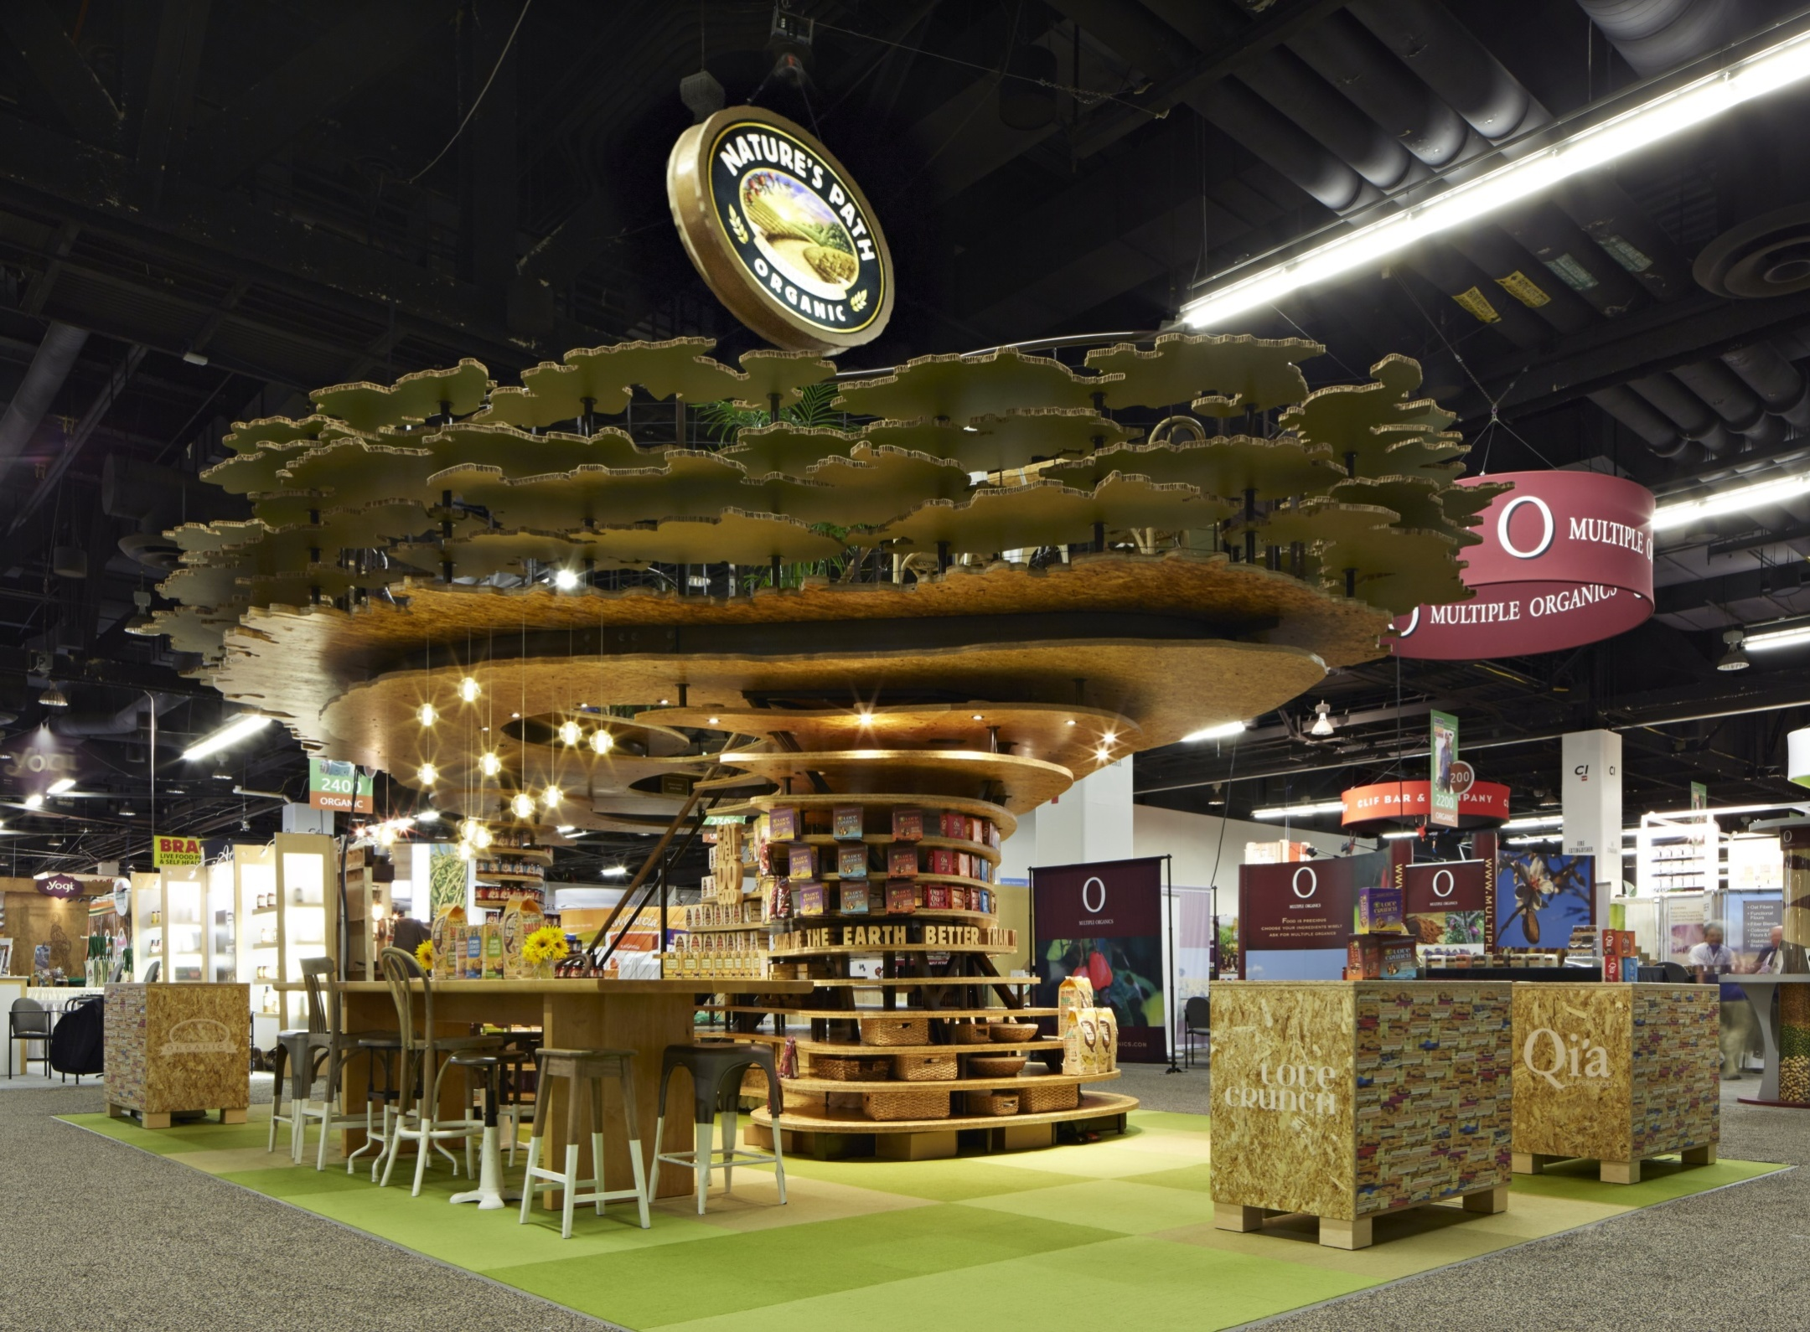

Slide 12
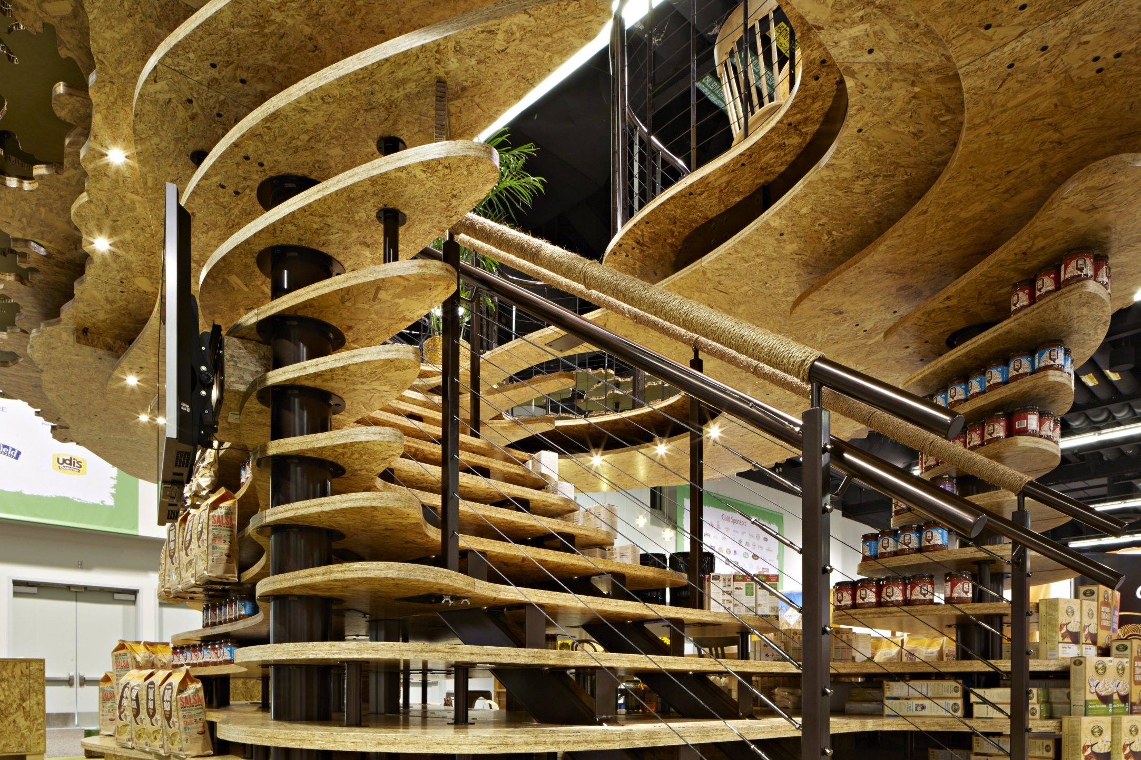

Slide 13
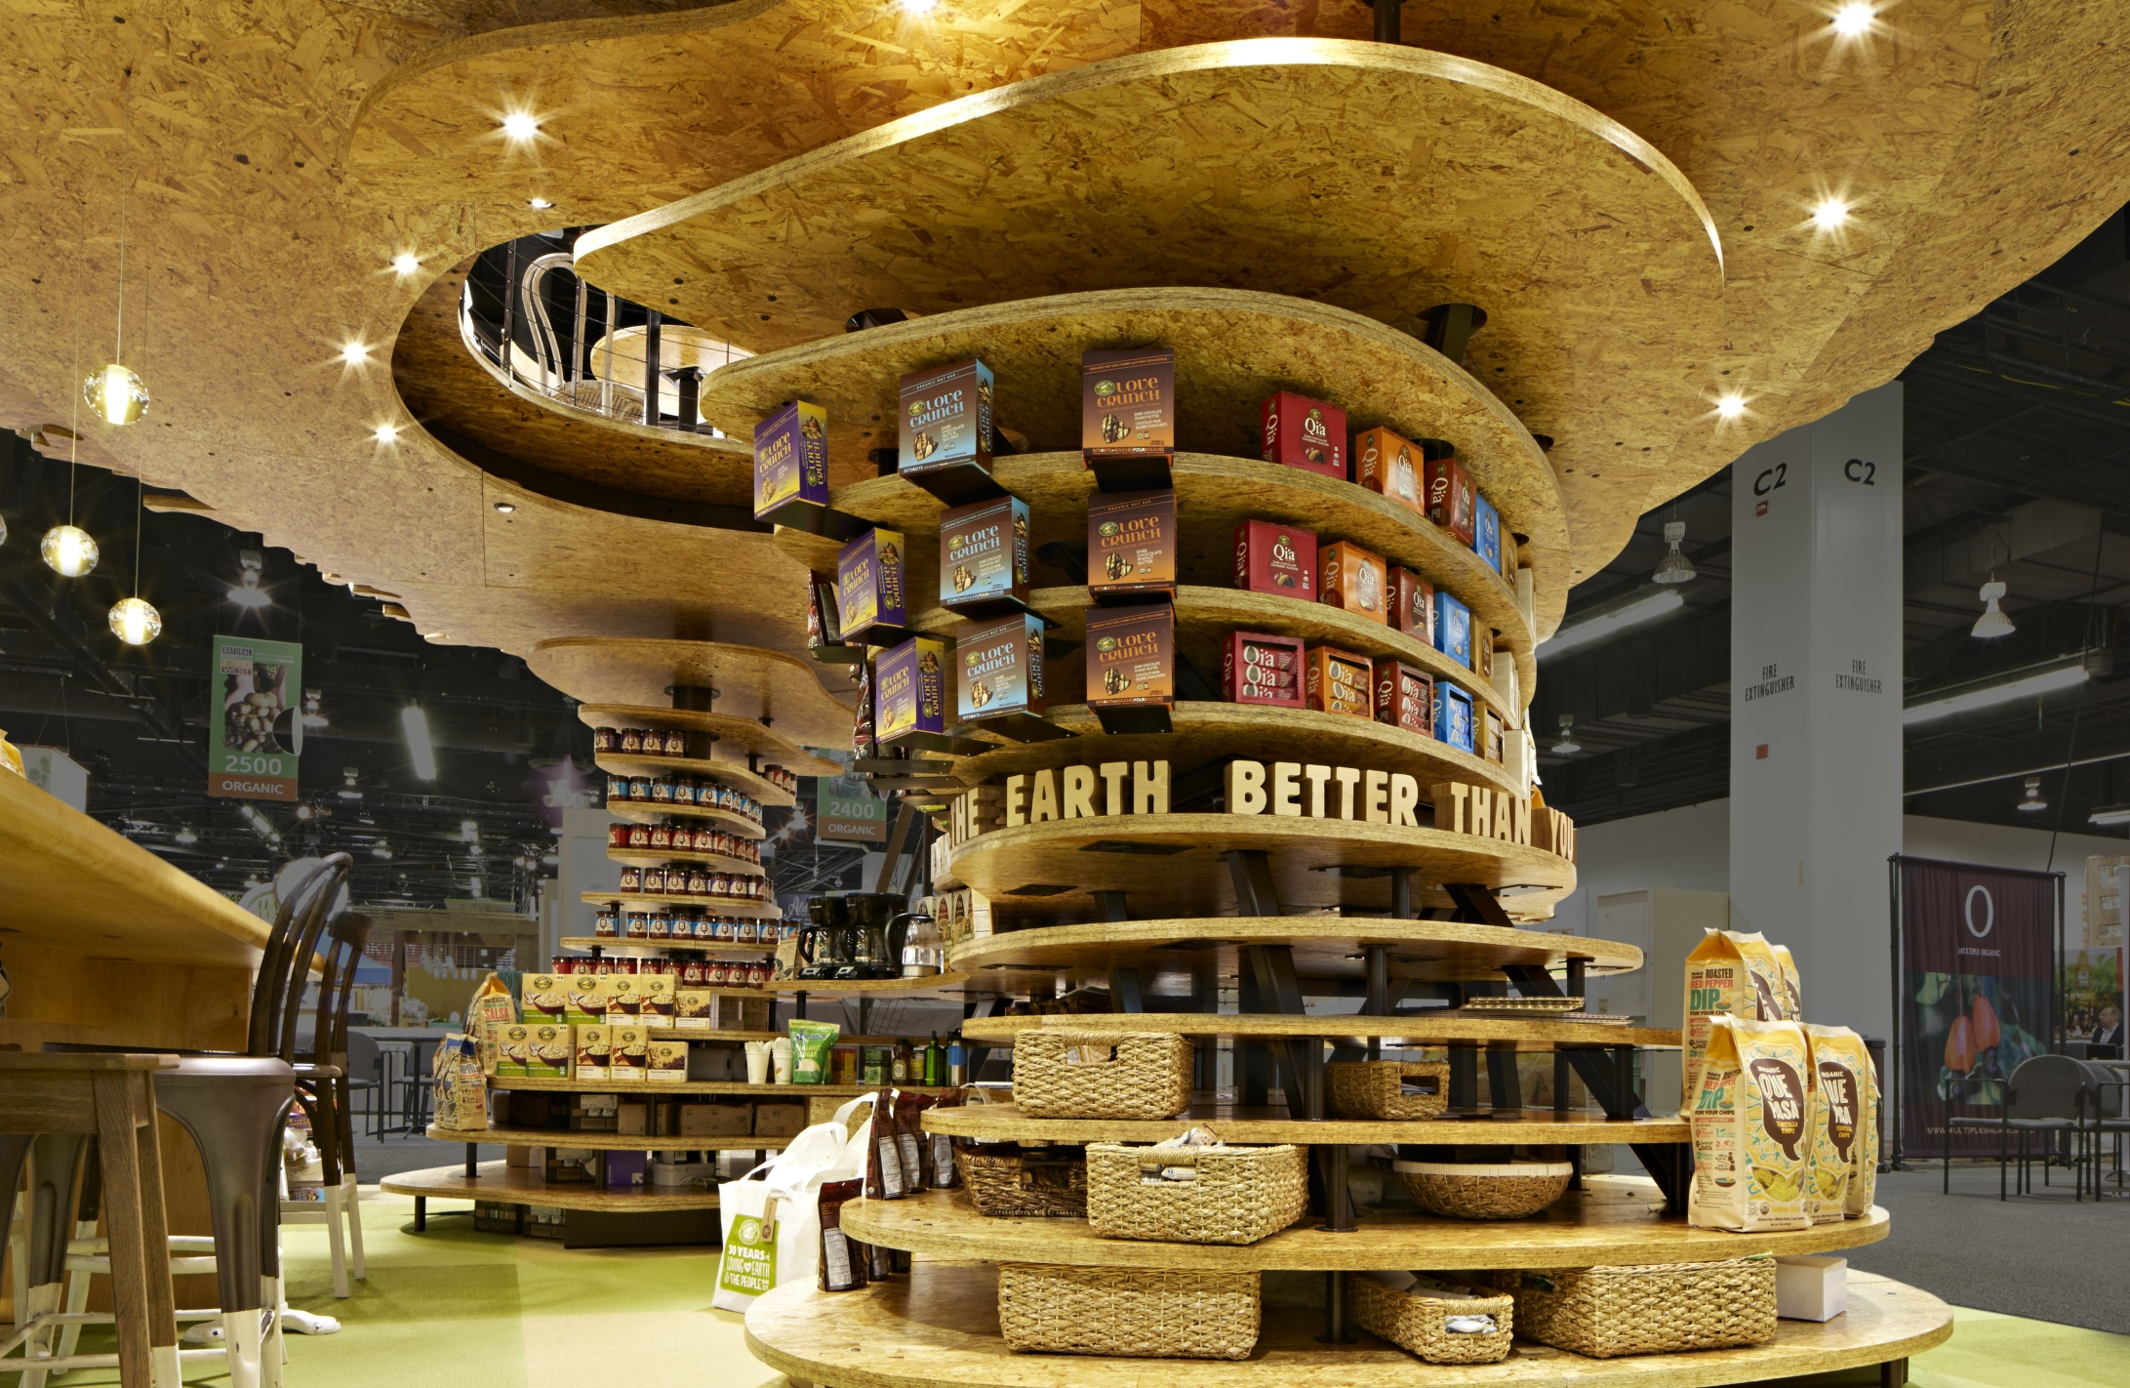

Slide 14
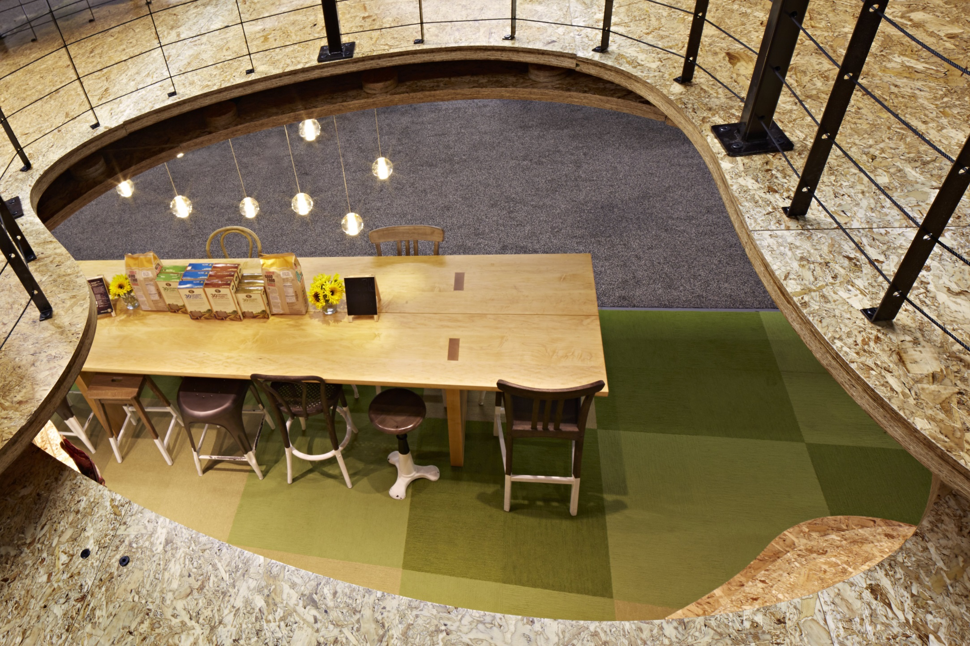

Slide 15
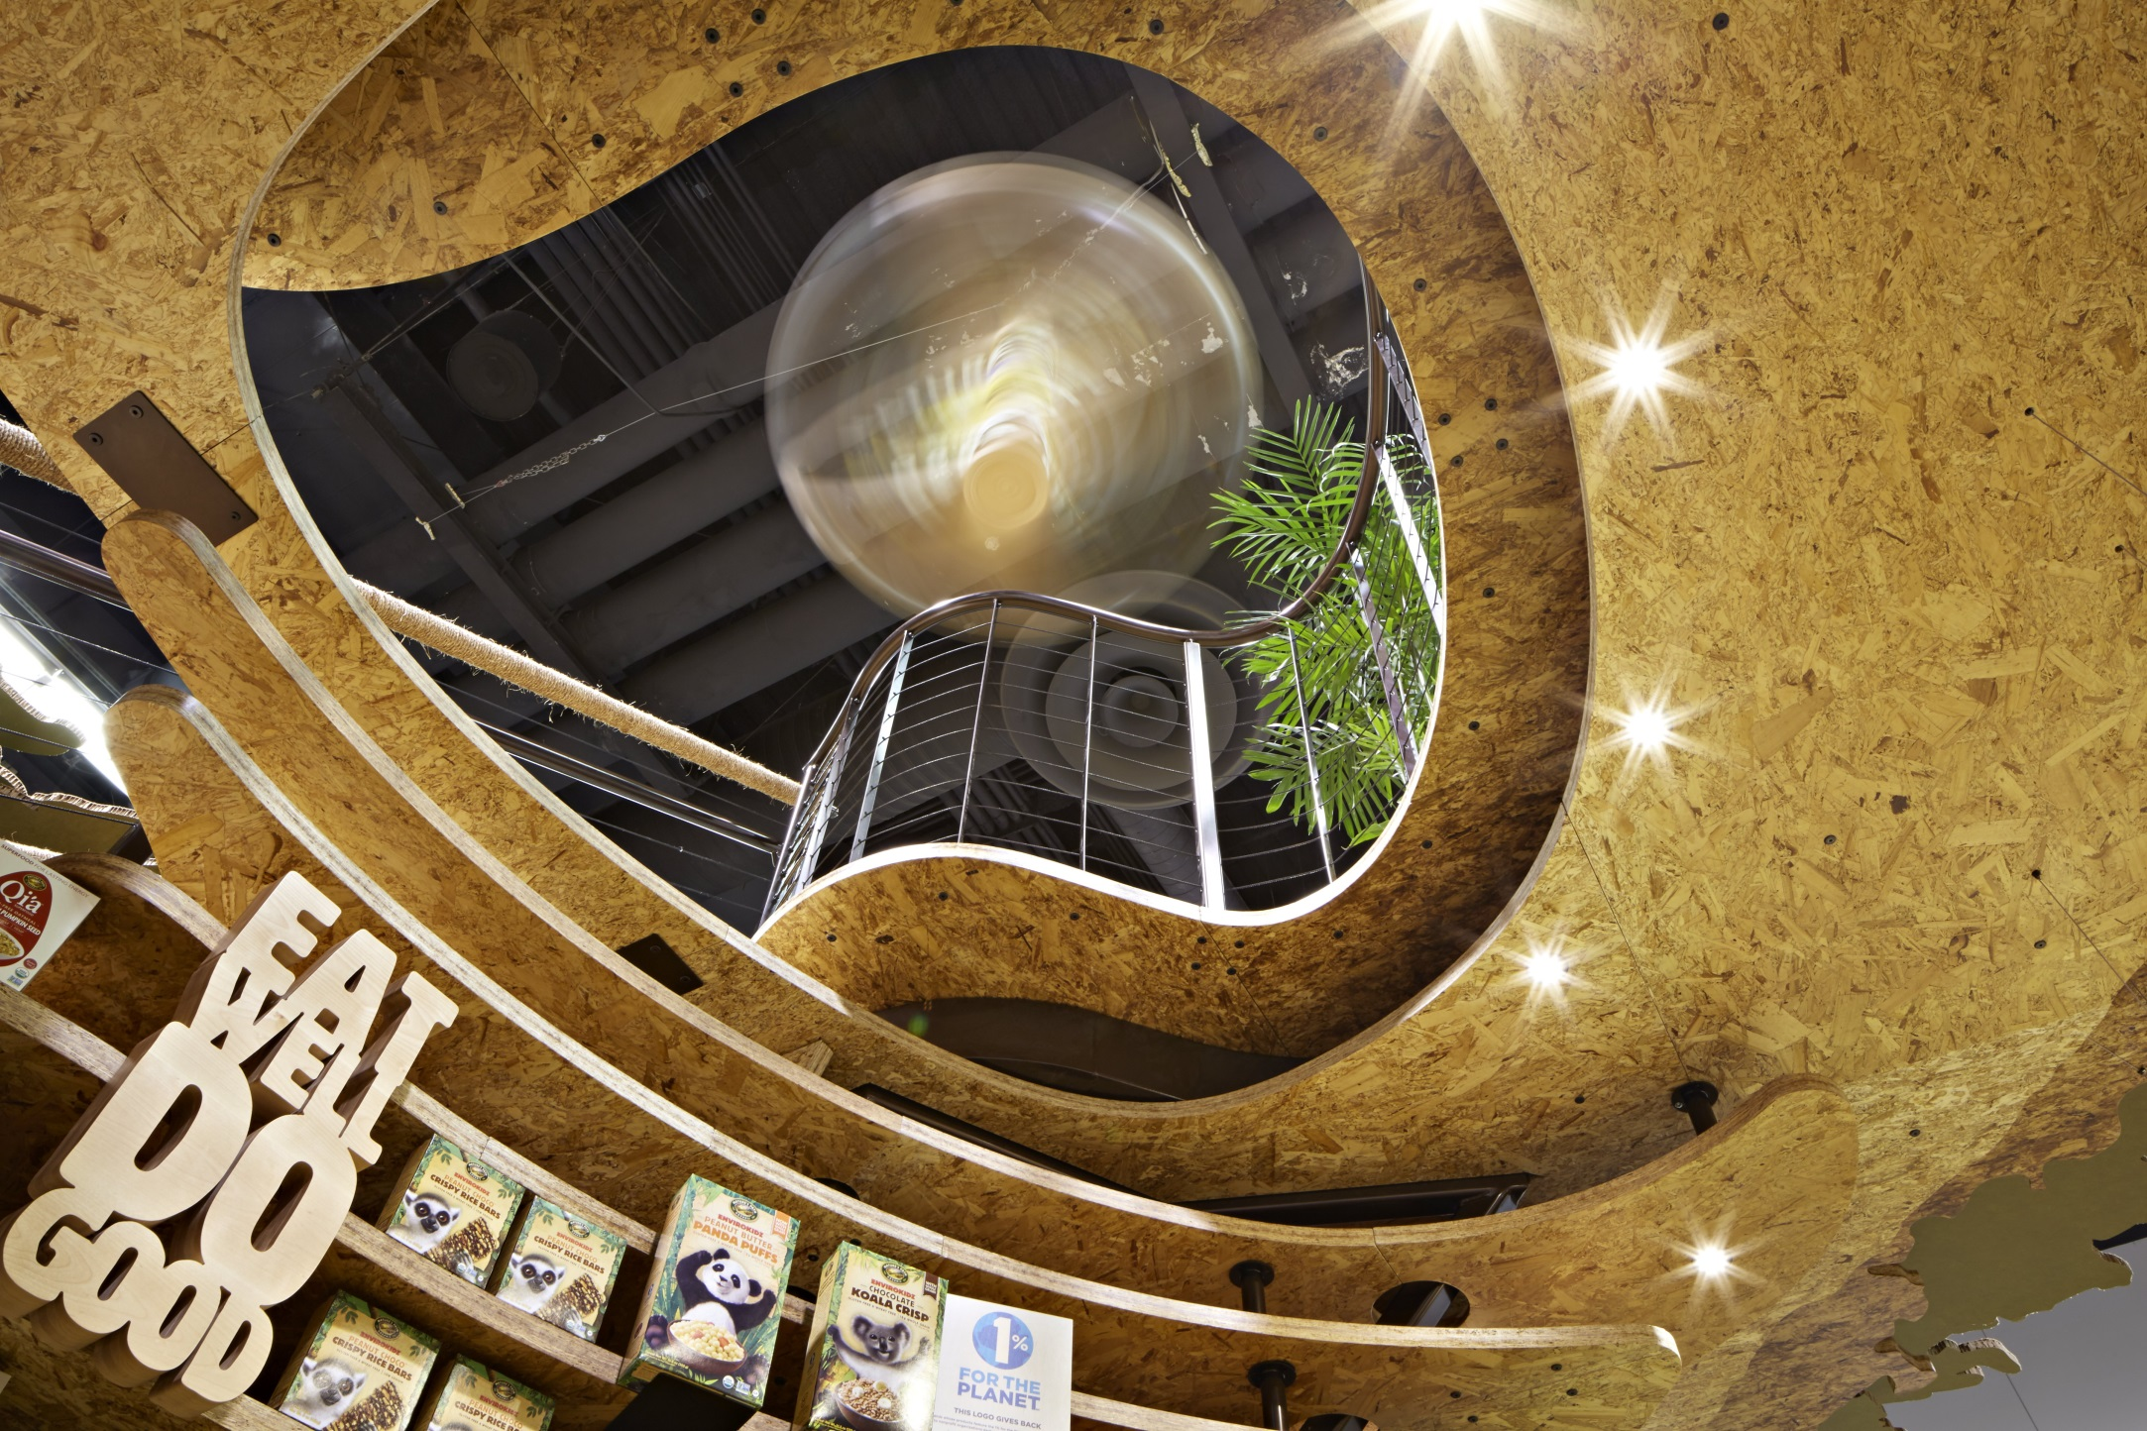

Slide 16
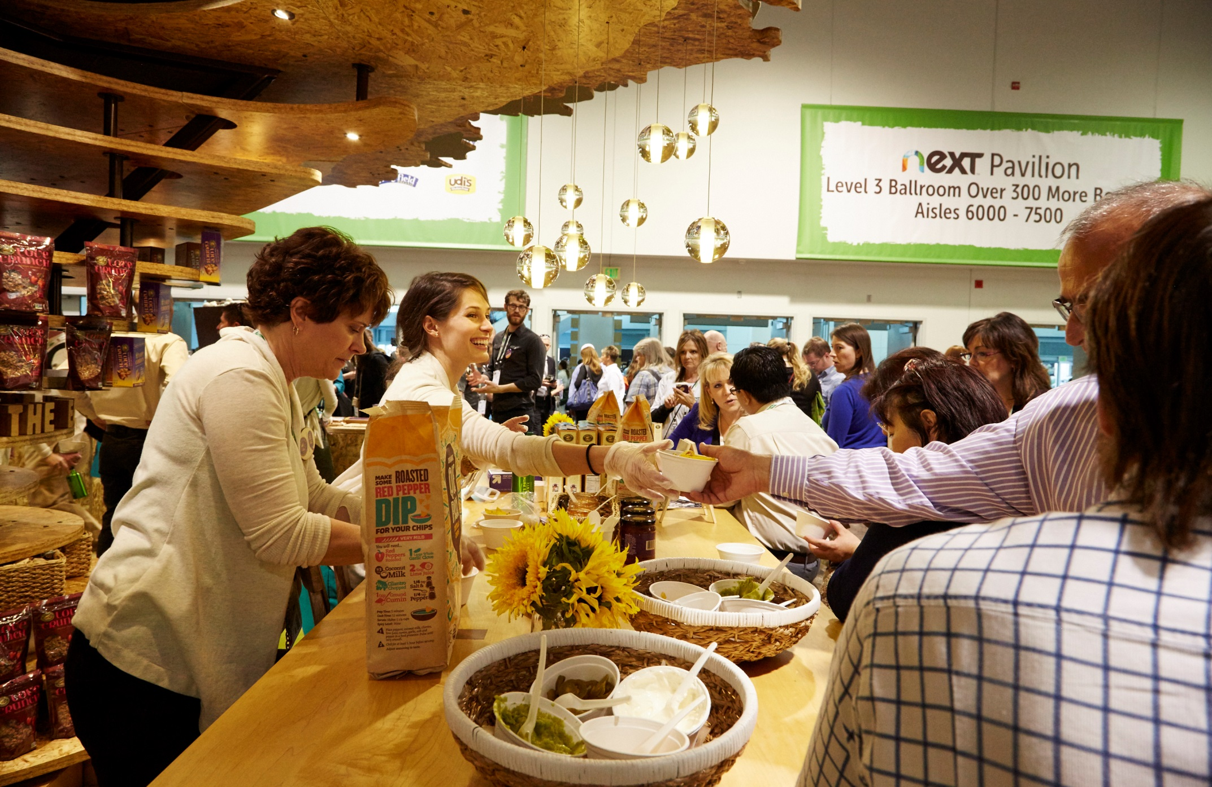
, The exhibit featured a ground-floor bar where staff handed out product samples.

Slide 17
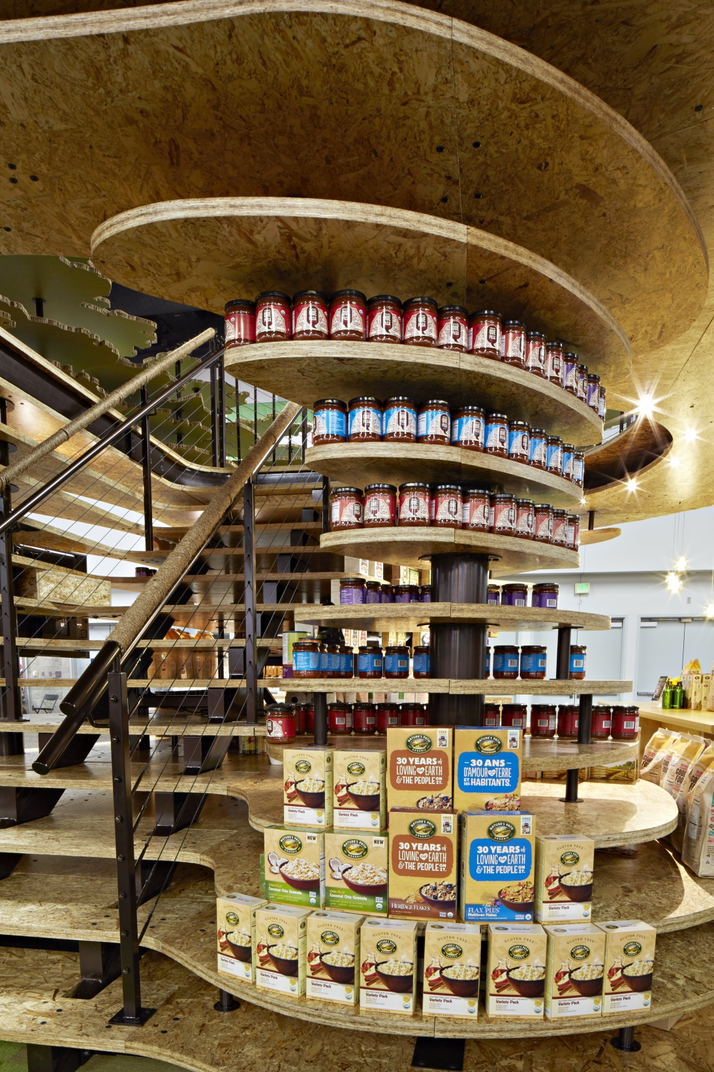

Slide 18


Slide 19
Nature’s Path Foods
Company: Nature’s Path provides healthy, great-tasting organic foods.
Design Challenges:
Nature’s Path was seeking a partner to realize an exquisitely ambitious design. The concept of floating topographical sections of a tree epitomized Nature’s Path commitment to sustainable, organic foods, referenced the visual identity, and celebrated the 30 year legacy of this family-owned company.
The concept drawings challenged physics and could only succeed with a team hell-bent on defending design through every phase of execution.
Honoring the aggressive design intent wasn’t the only measure of success, the project would have to be sustainable as well. Nature’s Path is a company committed to the journey toward sustainability in all they do. The exhibit project had to conform to that ideal.
The layered tree and canopy had to appear to float, yet had to stand without rigging, or columns otherwise the drawings would never be more than drawings. All this and the tree had to be a comfortable, interesting meeting experience space.

Slide 20
Nature’s Path Foods
Solutions:
A couldn't-miss beacon on the trade show floor, the 20-by-30-foot exhibit for Nature's Path was dominated by a towering 12-foot-tall "tree." Paying homage to the exhibitor's organic products, the structure comprised mainly Green components, including everything from Falconboard to water-based adhesives and finishes.
All materials used for the project were selected according to recycled content, end-of-life recyclability and their environmental impact in manufacturing.
Water based adhesives and finishes were used on FSC certified woods. Raw steel was used for all structural support framing, renewable/recyclable carpet squares were used on the floor and the upper canopy of the tree was created from sustainably sourced, SFI-certified panels.
Counters featured upcycled Nature’s Path cereal boxes. All lighting fixtures used in the space were LED to minimize energy consumption.

Slide 21
Contact Info
Design
Pinnacle Exhibits Inc., Bob Gilligan, 972-317-1009, Gilligan@pinnacle.com
Rural/Urban/Fantasy (RUF) Project, Jada Jones, 972-317-1009, jada@pinnacle.com
Fabrication
Pinnacle Exhibits Inc., Bob Gilligan, 972-317-1009, Gilligan@pinnacle.com
Photography
Michael Taft Photography LLC
Videography
Michael Taft Photography LLC

